Slide 1
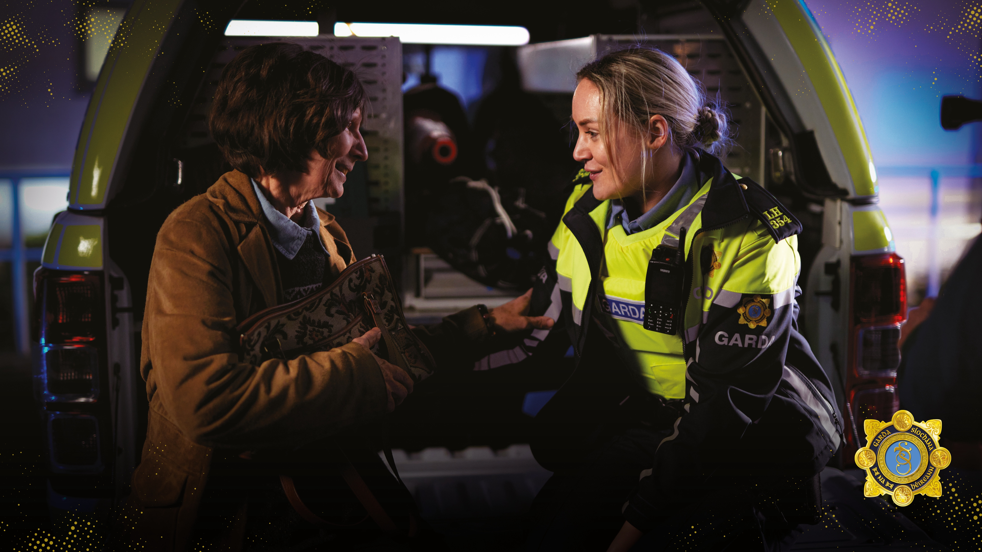


Slide 2
Who can join An Garda Síochána?
To be eligible for selection as a Garda Trainee, an applicant must:
Be of good character.
Be certified by a Registered Medical Practitioner (nominated by the Commissioner) to be in good health, of sound constitution and suited physically and mentally to performing the duties of a member of the service.
Have passed a Physical Competence Test and such other tests as may be determined by the Commissioner.
Be between the ages of 18 and 34. (Be 18 years of age but not yet 35 years of age at midnight on the 16th March 2022).
Be a national of an EU Member State, an EEA State, the United Kingdom of Great Britain and Northern Ireland or the Swiss Confederation or a refugee, or a family member of such a person, in relation to whom a refugee declaration is in force and continues to be in force for the entire duration of the Garda Recruit
selection and admissions process, or a person granted subsidiary protection, or a family member of such a person, in relation to whom a subsidiary protection declaration is in force and continues to be in force for the entire duration of the Garda Recruit selection and admissions process, or have had a period of one year’s continuous residence in the State and, during the 8 years immediately preceding that period, has had a total legal residence in the State amounting to 4 years.
Be proficient in the Irish language and/or the English language.
Must have relinquished all previous employment prior to entry to the Garda College and may not be on a career break from any such employment upon entry.
Have obtained an Irish Leaving Certificate with a grade D3 or O6 minimum in five subjects at Ordinary Level, or hold a Level 5 Major award (120 credits) on the National Framework of Qualifications (NFQ), or hold a recognised qualification (at Level 5 or greater), deemed
comparable to the aforementioned qualifications as determined by Quality and Qualifications Ireland (QQI).

Slide 3
APPLICATION PROCESS
Create a profile/ log in to publicjobs.ie
Fill out the online application form for selecting one of the 3 streams
  General
  Irish Language
  Garda Reserve
Assessment tests
Competency based interview
Garda Appointments Process – physical, medical, drug and vetting

Slide 4
THREE STREAMS
There are three streams:
General
Proficiency in Irish Language
Garda Reserves
See next slide for requirements.
Candidates who indicate their interest in this stream who are invited through to the final stages of the selection process will be required to undergo a competency based interview in Irish prior to being considered for such a position.
They must demonstrate a minimum Level B2 on the Europass self-assessment framework.
Candidates appointed from this stream must be able to provide a full range of services in Irish. If successful, candidates will be allocated to Gaeltacht areas for a period of time as and when determined by the Garda Commissioner
To be eligible to apply under this stream you must have:
Be a Garda Reserve at the time of application
Completed their probationary period
Performed their role to a satisfactory standard
Served a minimum of 120 hours per year for two of the last four claim years
Fulfilled the conditions for entry as set for candidates at PublicJobs.ie

Slide 5
What are the requirements?
EDUCATION
CITIZENSHIP
be a national of a European Union Member State; or
be a national of a European Economic Area State, the United Kingdom of Great Britain and Northern Ireland or the Swiss Confederation; or
Under the International Protection Act, 2015 and in compliance with the Admissions and Appointments Regulations 2013, as amended, be (i) a refugee or a family member of such a person in relation to whom a refugee declaration is in force and continues to be in force for the entire duration of the Garda Recruit selection and admissions process or (ii) a person granted subsidiary protection or a family member of such a person in relation to whom a subsidiary protection declaration is in force and continues to be in force for the entire duration of the Garda Recruit selection and admissions process; or
by the closing date of the advertisement of this competition, have had a period of one year’s continuous residence in the State, and during the eight years immediately preceding that period, have had a total residence in the State amounting to four years.
PHYSICAL
Applicants are expected to be aerobically fit in order to safely undergo training. All applicants will undergo a Physical Competence Test as part of the application process.
Applicants must pass all elements of the test and there is strictly no deviation from the format of the test. Successful applicants must maintain their fitness during the Foundation Training Programme.
Failure to maintain the required levels of fitness during training will be a breach of contract and constitute a termination of contract.
A demonstration video and detailed information regarding the Physical Competence Test are available on the Garda website.
By the closing date of the competition applicants must:
have obtained an Irish Leaving Certificate with a grade D3 or O6 minimum in five subjects at Ordinary Level*, or
hold a minimum of a Level 5 Major award (120 Credits) on the National Framework of Qualifications (NFQ), or
hold a recognised qualification (at Level 5 or greater), deemed comparable to the above in terms of both level and volume of learning as determined by QQI AND
be proficient in either or both of the following:
  the Irish language
  the English language

Slide 6
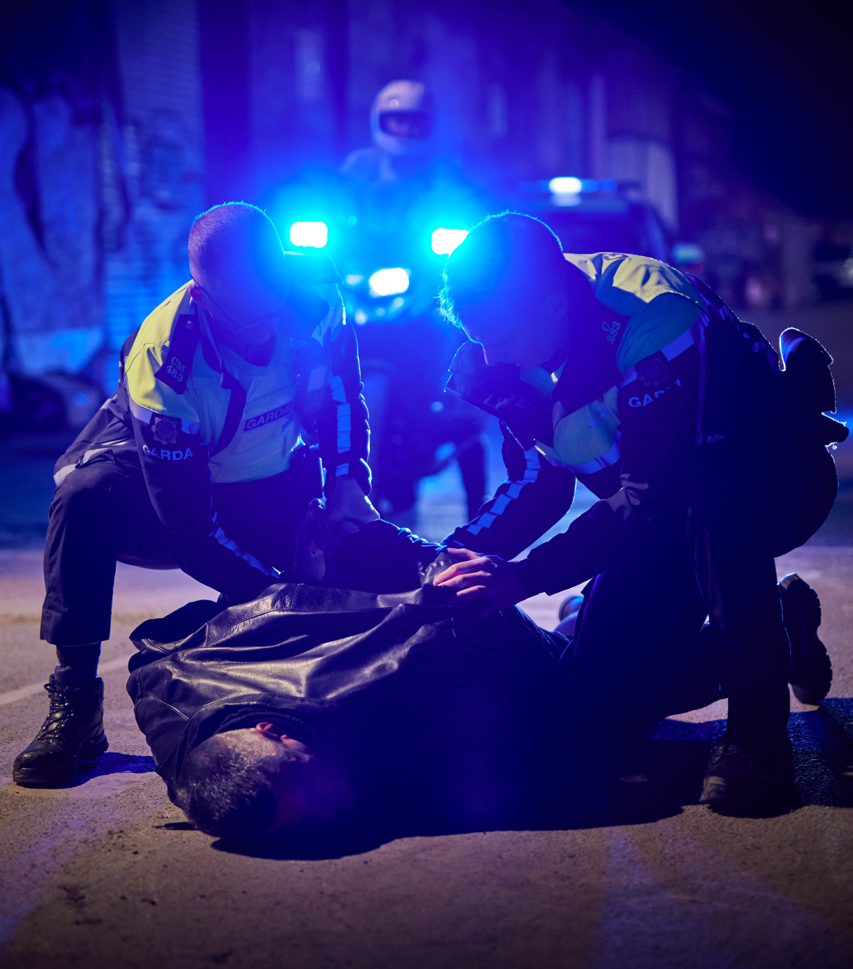




Allowances
Garda Trainees will receive an allowance of €184 per week for the 33 weeks leading to attestation.
Accommodation and food is provided by An Garda Síochána while resident in the Garda College.

Slide 7
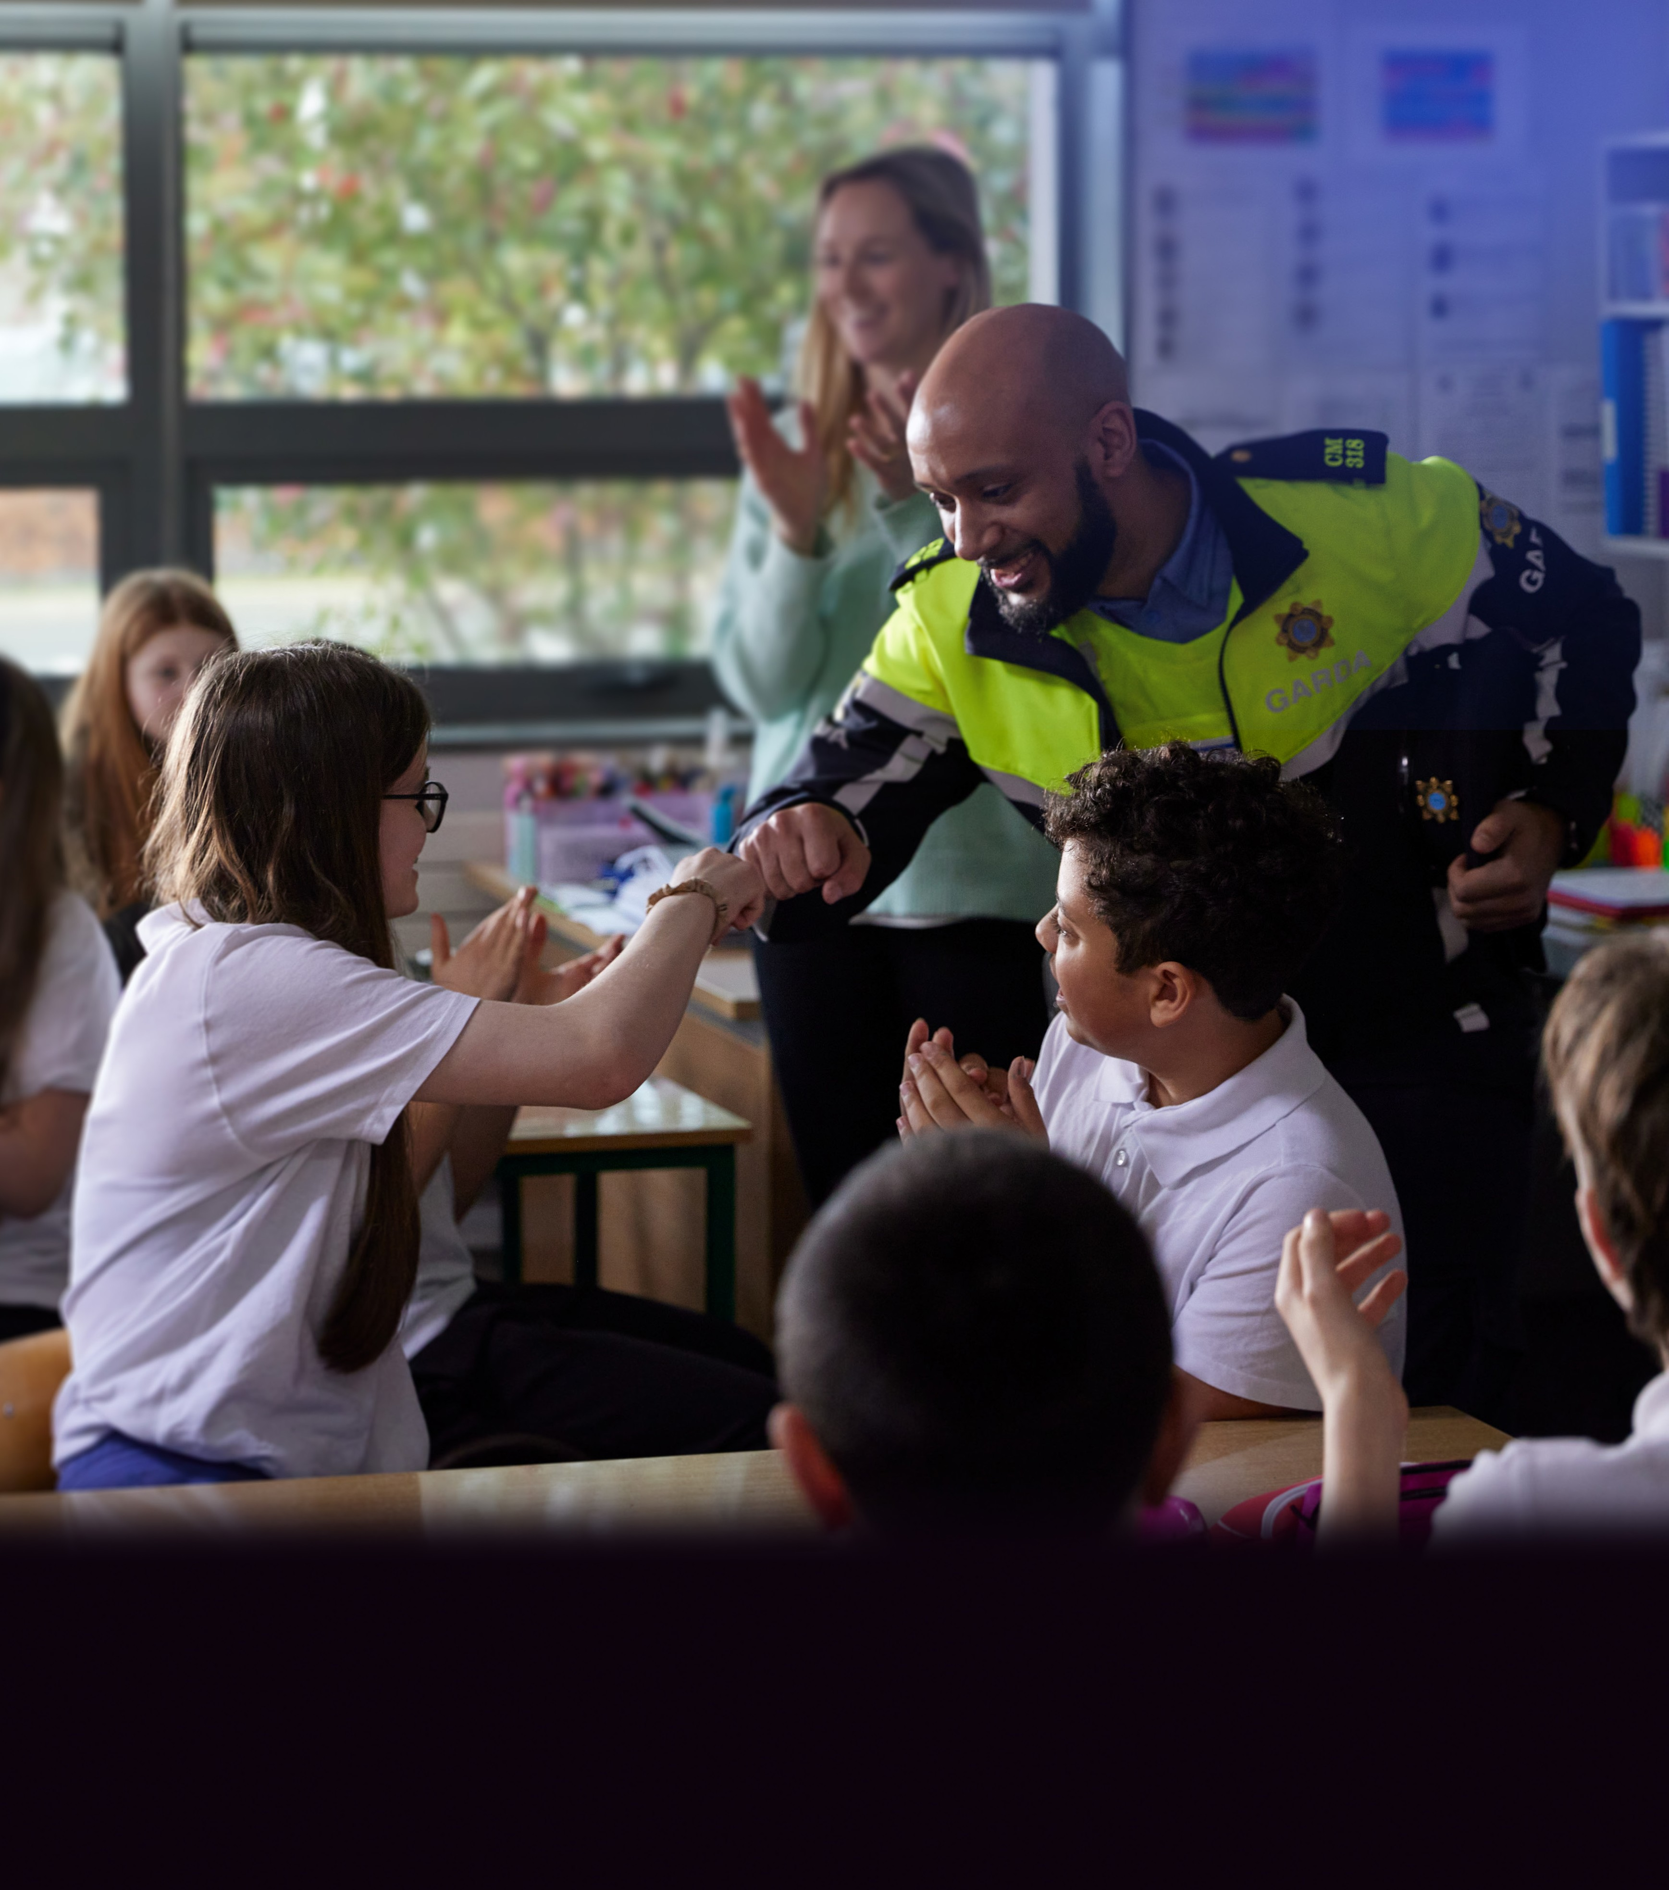
“Since its foundation, An Garda Síochána,has consistently and proudly placed our high standards at the heart of the policing service we provide.
It is the responsibility of all personnel to maintain Human Rights as a foundation for policing and to uphold the ethical standards as set out.”
Drew Harris, Garda Commissioner

Slide 8
THANK YOU

