Slide 1



Slide 2
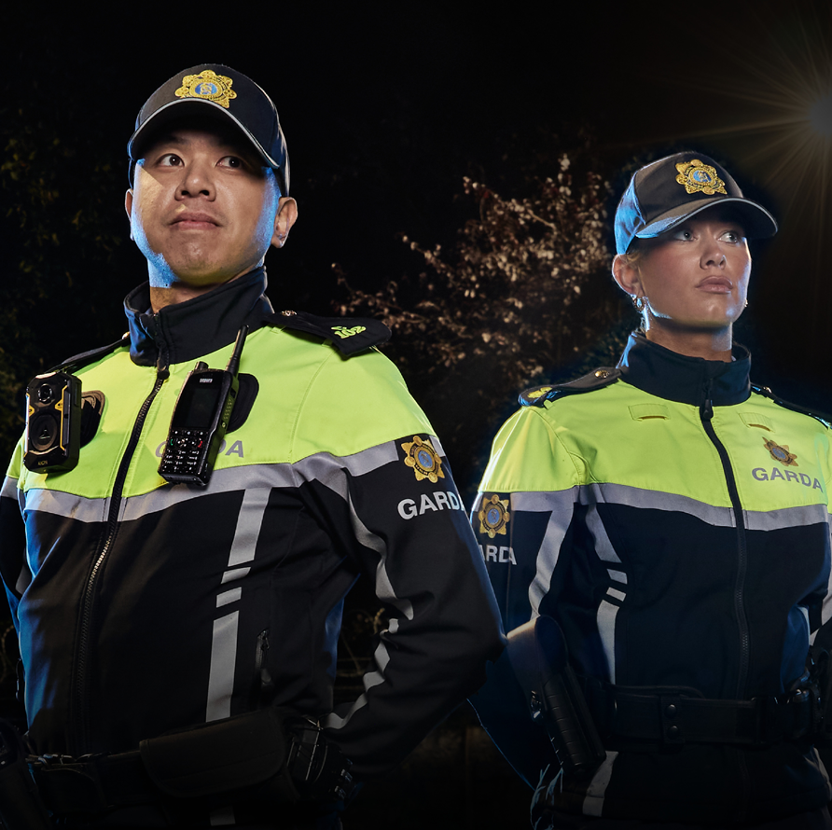

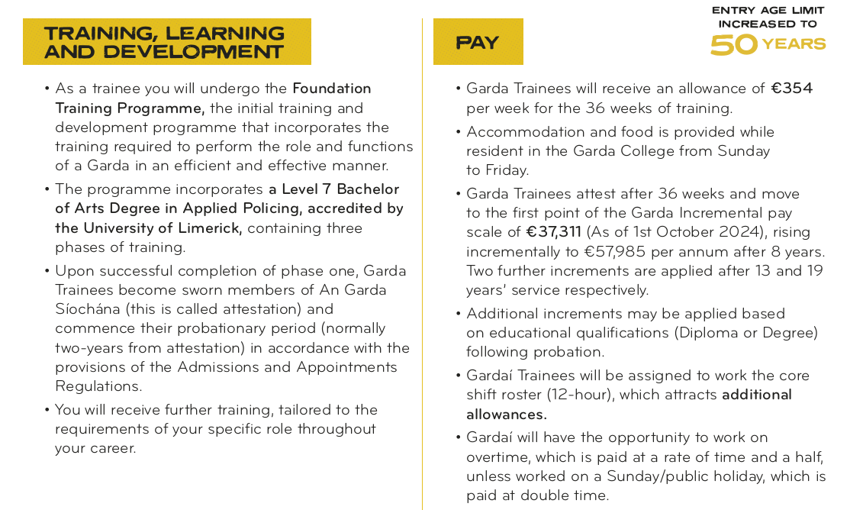
Why join An Garda
Síochána?
.

Slide 3
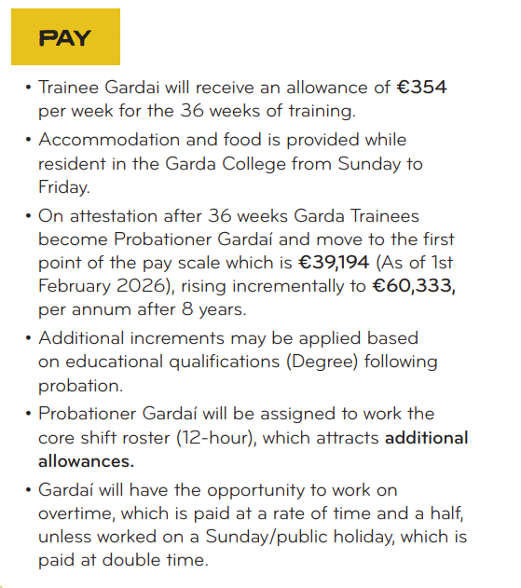
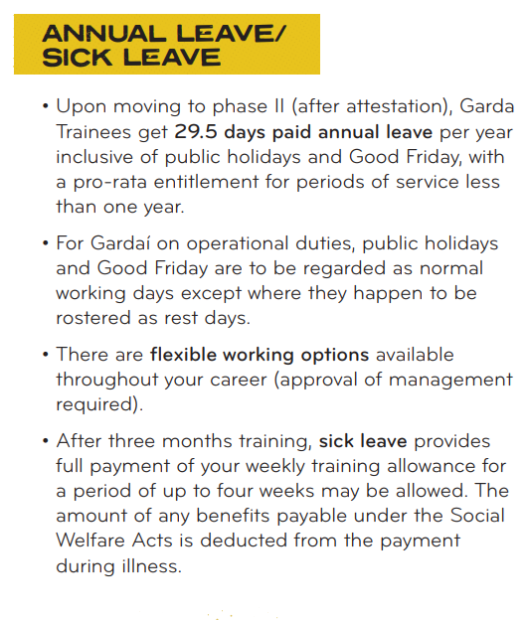
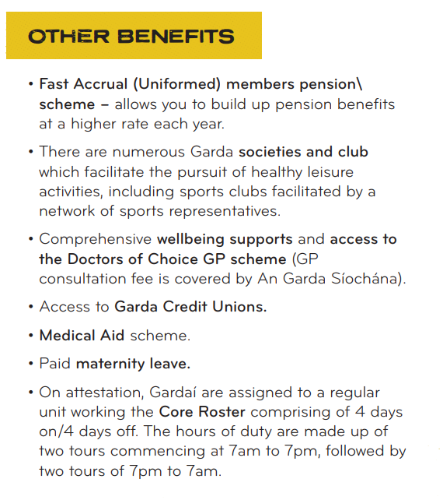
Why join An Garda Síochána?
.

Slide 4
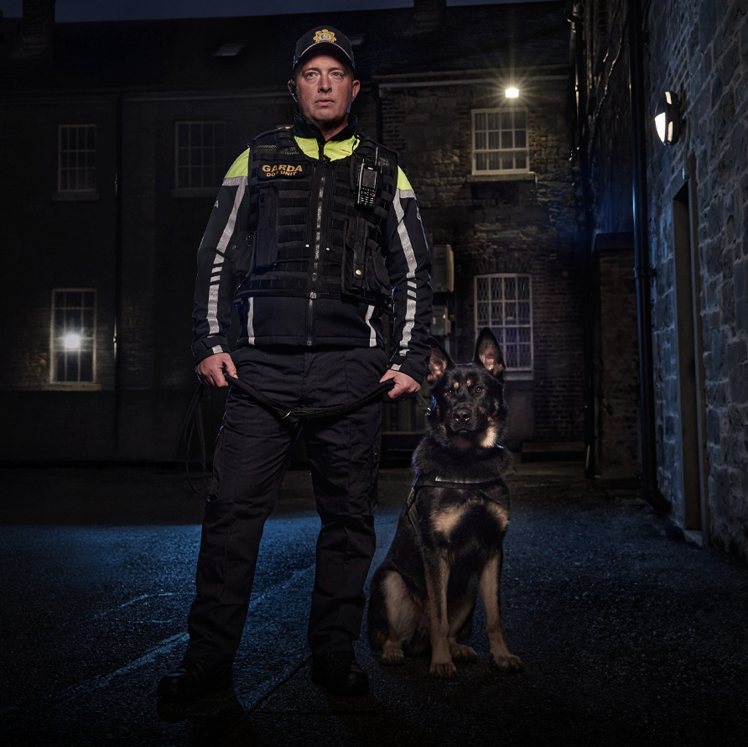
Application Process
Create a profile/ log in to publicjobs.ie
Fill out an online application form choosing one of the three streams. A separate application is required if you are applying under more than one stream.
    General
    Irish Language
    Eligible Serving Garda Reserves
Assessment tests (Candidates are permitted to sit the selection tests etc. only once even if applying for multiple competitions.)
Competency-based interview
Garda Appointments process – physical, medical, drug and vetting

Slide 5

Application Options
General
Proficiency in Irish Language
Eligible Serving Garda Reserves
See next slide for requirements.
Candidates who indicate their interest in this stream who are invited through to the final stages of the selection process will be required to undergo a competency-based interview in Irish prior to being considered for such a position.
They must demonstrate a minimum Level B2 on the Europass self-assessment framework.
Candidates appointed from this stream must be able to provide a full range of services in Irish. If successful, candidates will be allocated to Gaeltacht areas for a period of time as and when determined by the Garda Commissioner.
To be eligible to apply under this stream you must:
Be a Serving Garda Reserve at the time of application
Have completed your probationary period.
Performed your role to a satisfactory standard
Served a minimum of 120 hours per year for two of the last four claim years
Fulfilled the conditions for entry as set for candidates at publicjobs.ie
** Irrespective of which competition you have applied for, you may only sit the Stage 1 tests of the selection process once. The scores you achieve will carry across the competitions for which you applied
Garda Band – Expression of Interest
Candidates with a musical background may indicate interest for a future audition for the Garda Síochána Band. This audition will only be available following successful completion of Garda training and the probationary period.

Slide 6
Who can join An Garda Síochána?
To be eligible for selection as a Garda Trainee, an applicant must:
You must have attained the age of 18 and be no more than the age of 49 by the closing date for receipt of applications to this competition on Wednesday, 3rd June 2026
Be of good character.
Be certified by a Registered Medical Practitioner (nominated by the Commissioner) to be in good health, of sound constitution and suited physically and mentally to performing the duties of a member of the service.
Successfully pass a Physical Competence Test and such other tests including a Substance Misuse (Controlled Drug and Psychoactive Substances) Assessment to the satisfaction of the Commissioner of An Garda Síochána.
Be a national of an EU Member State, an EEA State, the United Kingdom of Great Britain and Northern Ireland or the Swiss Confederation or a refugee, or a family member of such a person, in relation to whom a refugee declaration is in force and continues to be in force for the entire duration of the Garda Recruit selection and admissions process;
or be a person granted subsidiary protection, or a family member of such a person, in relation to whom a subsidiary protection declaration is in force and continues to be in force for the entire duration of the Garda Recruit selection and admissions process;
or have had a period of one year’s continuous residence in the State and, during the 8 years immediately preceding that period, has had a total legal residence in the State amounting to four years
Have obtained an Irish Leaving Certificate with a grade D3 or O6 minimum in five subjects at Ordinary Level, or hold a Level 5 Major award (120 credits) on the National Framework of Qualifications (NFQ), or hold a recognised qualification (at Level 5 or greater), deemed comparable to the aforementioned qualifications as determined by Quality and Qualifications Ireland (QQI).
Be proficient in either or both the Irish language and English language. Successful applicants are required to study and pass Irish as part of a module in the Garda College.
Must have relinquished all previous employment prior to entry to the Garda College and may not be on a career break from any such employment upon entry.

Slide 7
What are the requirements?
EDUCATION
CITIZENSHIP
be a national of a European Union Member State; or
be a national of a European Economic Area State, the United Kingdom of Great Britain and Northern Ireland or the Swiss Confederation; or
Under the International Protection Act, 2015 and in compliance with the Admissions and Appointments Regulations 2013, as amended, be (i) a refugee or a family member of such a person in relation to whom a refugee declaration is in force and continues to be in force for the entire duration of the Garda Recruit selection and admissions process or (ii) a person granted subsidiary protection or a family member of such a person in relation to whom a subsidiary protection declaration is in force and continues to be in force for the entire duration of the Garda Recruit selection and admissions process; or
by the closing date of the advertisement of this competition, have had a period of one year’s continuous residence in the State, and during the eight years immediately preceding that period, have had a total residence in the State amounting to four years.
PHYSICAL
Applicants are expected to be aerobically fit in order to safely undergo training. All applicants will undergo a Physical Competence Test as part of the application process.
Applicants must pass all elements of the test and there is strictly no deviation from the format of the test. Successful applicants must maintain their fitness during the Foundation Training Programme.
Failure to maintain the required levels of fitness during training will be a breach of contract and constitute a termination of contract.
A demonstration video and detailed information regarding the Physical Competence Test are available on the Garda website.
By the competition closing date 3rd June 2026 applicants must:
have obtained an Irish Leaving Certificate with a grade D3 or O6 minimum in five subjects at Ordinary Level*, or
hold a minimum of a Level 5 Major award (120 Credits) on the National Framework of Qualifications (NFQ), or
hold a recognised qualification (at Level 5 or greater), deemed comparable to the above in terms of both level and volume of learning as determined by QQI AND
be proficient in either or both of the following:
  the Irish language
  the English language

Slide 8
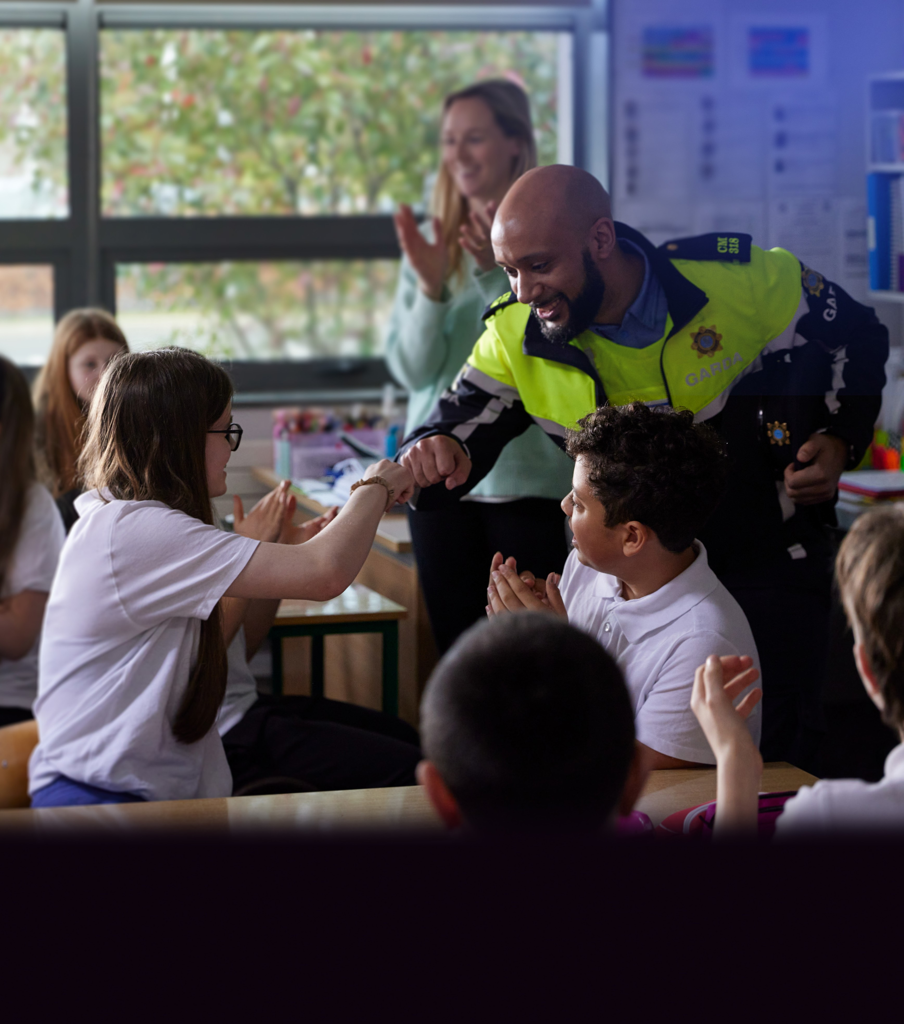
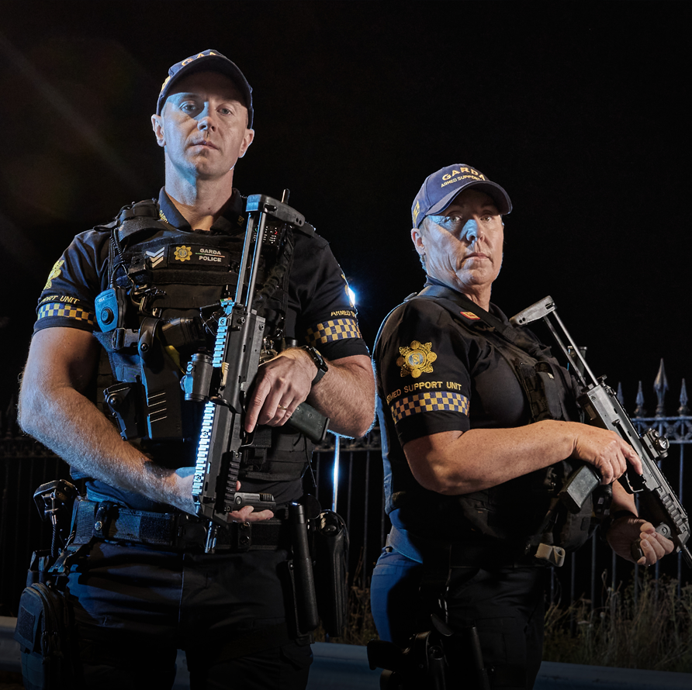




“Being a Garda is a tough job, but I know from personal experience how rewarding it can be. There are not many jobs where you can make a positive difference to people and communities every day.
It can also offer career opportunities in varied and interesting roles. As a Garda you can make a significant contribution to public safety through a variety of roles, including community policing, investigating domestic abuse, and tackling organised crime.
I want to encourage people from all backgrounds to join An Garda Síochána. It is important that we represent the communities we serve.
Being a Garda is definitely a job worth doing.”
Justin Kelly Garda Commissioner

Slide 9
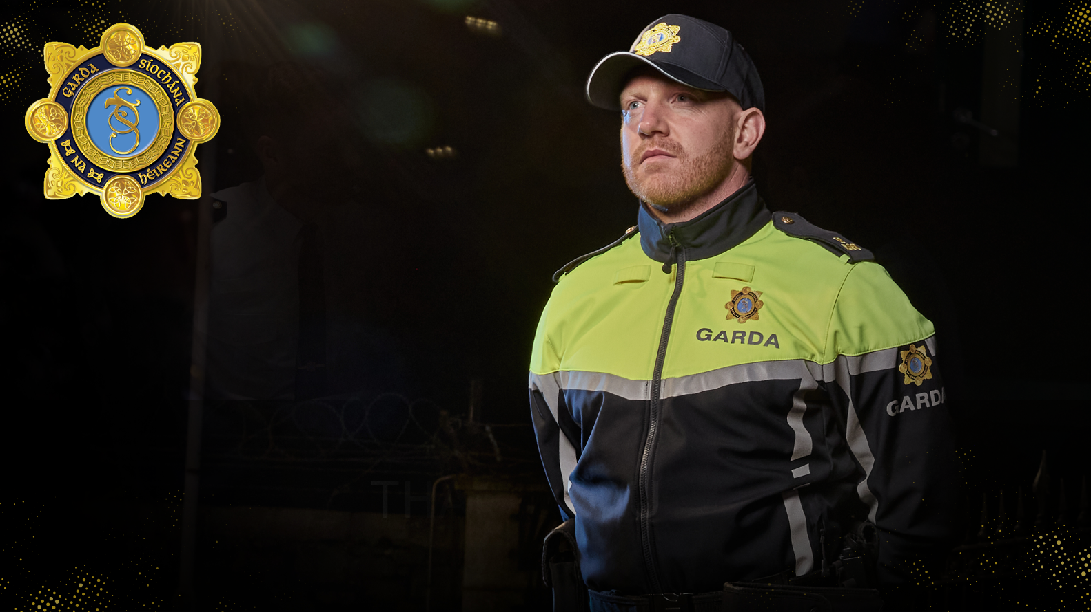
THANK YOU

