Slide 1
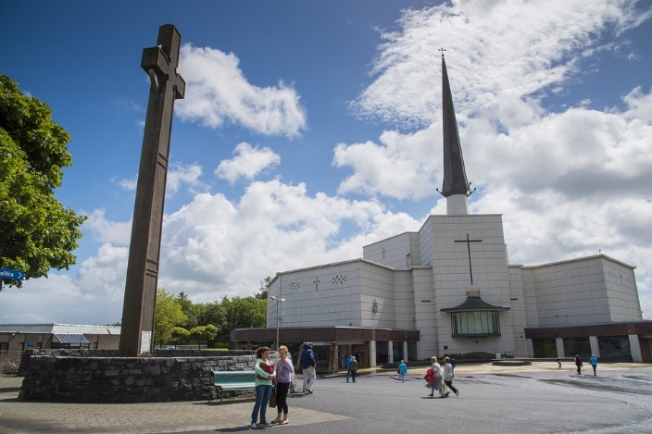

An Garda Síochána
Claremorris
World Meeting of Families
August 2018

Slide 2
Overview
Knock Shrine| Sunday 26th August 2018
Road closures in place from 6pm on Saturday evening
Get on a Private coach or carpool to and from the event
No public viewing opportunities at Knock Airport

Slide 3
Travel Advice
We encourage people travelling to Knock Shrine on Sunday the 26th August to use buses, rail or car pool to travel to the event.
Private buses
There will be designated parking area on the N17 for buses that travel to Knock Shrine. The advantage of travelling to the event by bus is that these patrons will have the shortest distance to walk to Knock Shrine via a short walkway from the N17 to the event site
Train
Iarnrod Eireann plan to operate special trains in addition to normal services. Bus Eireann will be operating shuttle buses between Claremorris Train Station and the outskirts of Knock Village. For further information: log on to www.irishrail.ie or contact Customer Care on1-850-366222

Slide 4
Travel Advice
We encourage people travelling to Knock Shrine on Sunday the 26th August to use buses, rail or car pool to travel to the event.
Bus Éireann
Knock is served by Bus Éireann routes 440 (Athlone – Knock, Westport – Castlebar - Knock), 421 (Swinford - Kiltimagh– Knock) and 64 (Galway – Knock - Sligo). Additional services will operate on these routes on the 26th August, space will be limited. For further information, log onto www.buseireann.ie or contact 1850-836611
Carpool Parking
There will be car parking available on the outskirts of Knock Village. Please note that there is a considerable walk from the car parks due to the size, scale and location of this event. There will be no shuttle bus facility available between the car parks and the event site.

Slide 5
Early Arrival
We advise early arrival to ensure ease of access to Knock Shrine and ask that all persons travelling to the event to plan your return travel arrangements in advance.

Slide 6
Road closures
N17
Closed from Charlestown to Claremorris
12midnight on Saturday 25 August - 3pm on Sunday 26 August
Limited & local access only
Ireland West Airport
Diversions on N17 for Departures/Arrivals to and from Ireland West Airport

Slide 7
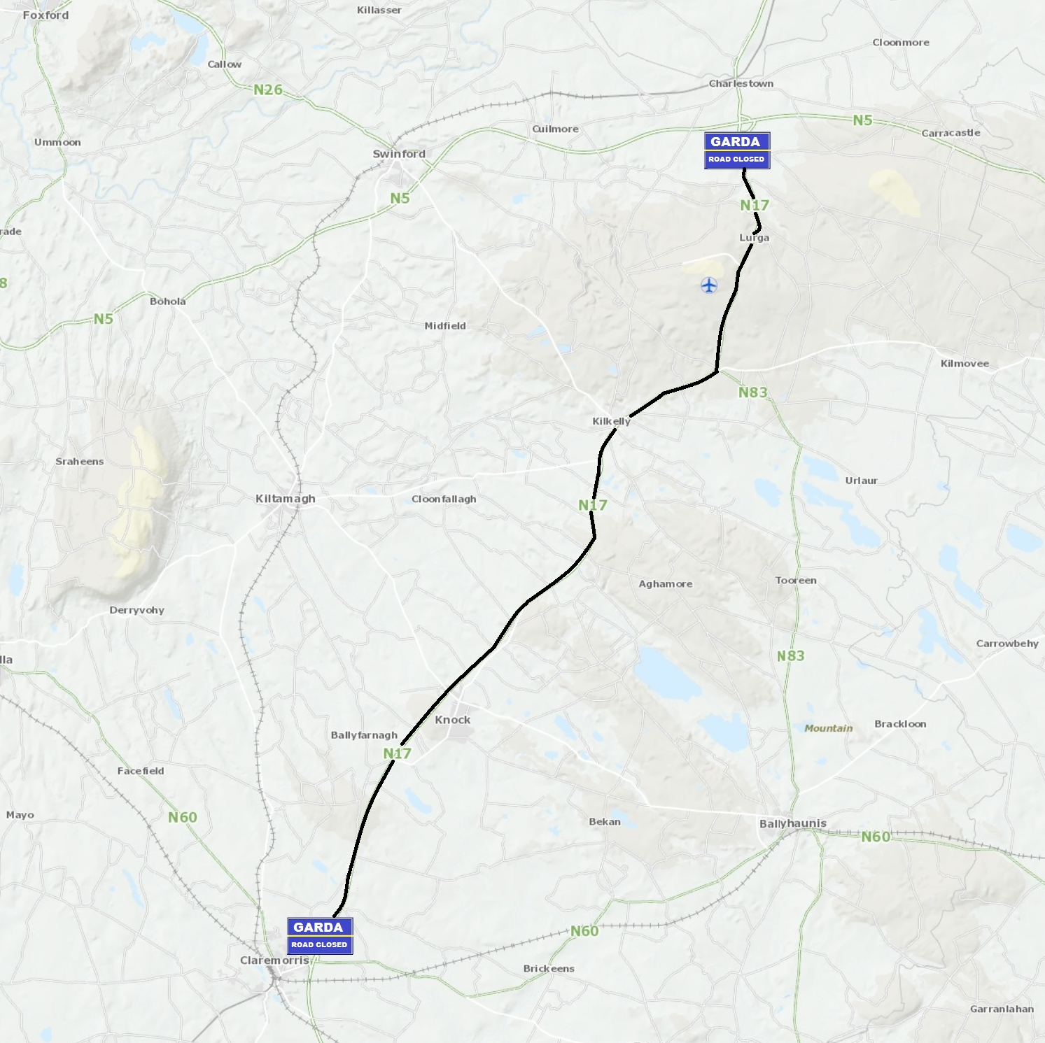
Road Closures – N17 (30 KM)
The traffic management plan will commence with the closure of the N17 at 12 midnight on Saturday 25th of August 2018 until approximately 3pm on Sunday 26th August. The N17 will be closed from Claremorris to Charlestown – 30 kilometres.
The N17 will be have limited access from Claremorris to Knock - restricted to residents and ticket holders only for the visit of Pope Francis to Knock Shrine.

Slide 8
Practical Advice
Please note the event in Knock is SOLD-OUT.
This event is taking place outdoors at Knock Shrine. Every adult and every child in attendance will require a ticket to access the Knock Shrine domain on 26th August 2018.
Under 18s must be accompanied by an adult. All tickets will be for standing sections.
Notes:
Going home:
There will be queues. Patience required at transport collection points.
Stay in group. Follow signs. Ensure all group members know route.
Anywhere up to four hours from standing position in park to where you started from.
Your phone may be charged, but if you’re calling someone who’s phone battery is gone or turned off you won’t get through.

Slide 9
Practical Advice
Prepare for a big journey
Allow yourself plenty of time to reach the venue. While there will be walking involved, there will be rest areas along the route for your comfort.
Some walking is unavoidable due to the size, scale and location of this event.
Please note that this is a standing event only.
Seek medical advice if you have any concerns about your ability to participate in an event of this scale.
Notes:
Going home:
There will be queues. Patience required at transport collection points.
Stay in group. Follow signs. Ensure all group members know route.
Anywhere up to four hours from standing position in park to where you started from.
Your phone may be charged, but if you’re calling someone who’s phone battery is gone or turned off you won’t get through.

